Slide 1
SS ZG653: Software Architecture Lecture 13: Adaptable Systems
Instructor: Prof. Santonu Sarkar
March 17, 2015

Slide 2
A brief Introduction to Reflection
Adaptable Systems

Slide 3
Basic Idea
Reflection pattern allows runtime discovery of interfaces and dynamic calling of discovered interfaces

Slide 4
Context and Problem
Context
Support for variation and change in the structure of the system
Create architecture that’s open to change
Problem
How to build systems that support unanticipated changes?

Slide 5
Solution
Encapsulate information about properties and variant aspects of the application’s structure, behavior, and state into a set of meta-objects.
Separate the meta-objects from the core application logic via a two-layer architecture:
The meta level contains the meta-objects
The base level contains the application logic.
Base-level objects consult an appropriate meta-object before they execute behavior or access state that potentially can vary.

Slide 6
Examples
Java offers Reflection through capabilities provided in the Java Reflection API
Broker Pattern – CORBA and RMI
offers Reflection in terms of its Dynamic Invocation Interface (DII) and Interface Repository
RMI

Slide 7
Reflection Pattern in CORBA
For the basic functionality CORBA supports the so called Dynamic Invocation Interface (DII) on the client-side
The CORBA Interface Repository is simply another CORBA object that stores the contents of IDL defined types
Once you add an IDL type to the repository, any other CORBA object can query the repository at runtime and:
dynamically understand an interface and make calls on it
dynamically manipulate an interface by adding or deleting interface methods

Slide 8
RMI and Reflection
Sun's Java Remote Method Invocation (RMI) is based on the Transparent Broker variant pattern
Java reflection is used to determine the properties, events and methods
This is turn is used to serialize an object while transmitting from one distributed component to another

Slide 9
Java Reflection Mechanism
Java to support Remote Method Invocation, object serialization, and JavaBeans
Reflection is used by JavaBeans to determine the properties, events, and methods that are supported by a particular bean
Java.lang.Class is the entrypoint for reflection
How Java reflection is used?
JUnit – uses reflection to parse @Test annotation to get the test methods and then invoke it.
Spring – dependency injection, read more at Spring Dependency Injection
Tomcat web container to forward the request to correct module by parsing their web.xml files and request URI.
Eclipse auto completion of method names
Struts
Hibernate

Slide 10
More on Java reflection
Class Level
Getting info regarding class, superclass, members, package, modifiers, methods, implemented interfaces
Field Level
Getting info on field types, get/set info
Method and constructor Level
Getting public methods and constructor information
Invocation of methods,
Instantiation of object by calling constructor
Annotation Level

Slide 11
Reflection Liabilities
Poor Performance
Since reflection resolve the types dynamically, it involves extra processing like scanning to find the class to load and introspect, causing slow performance.
Security Restrictions
Reflection requires runtime permissions that might not be available for system running under security manager. This can cause you application to fail at runtime because of security manager.
Security Issues
Using reflection we can access part of code that we are not supposed to access, for example we can access private fields of a class and change it’s value. This can be a serious security threat and cause your application to behave abnormally.
High Maintenance
Reflection code is hard to understand and debug, also any issues with the code can’t be found at compile time because the classes might not be available, making it less flexible and hard to maintain.

Slide 12
Patterns and Tactics
Tactics are building blocks using which patterns are created
A pattern without any tactic is not useful
Architectural Pattern and Modifiability
 | Localize Change |  |  | Reduce ripple effect |  |  | Defer Binding
PATTERN | Increase semantic coherence | Factor common services | Generalize | Maintain existing interface-wrapper | Restrict communication path | Use intermediary | Use runtime registration | Config file- startup time decision | Runtime binding
Layering | X | X | X |  | X | X
Pipe-n-filter | X |  |  |  | X
Blackboard | X | X | X |  | X | X
Broker | X | X | X |  | X | X | X |  | X
MVC |  |  |  |  | X |  |  |  | X
Microkernel | X | X |  |  | X | X
Reflection | X

Slide 13
SS ZG653: Software Architecture Lecture 13: Introducing Design Pattern
Instructor: Prof. Santonu Sarkar
March 17, 2015

Slide 14
Design Patterns
A Pattern presents a proven advice in standard format
A design pattern gives advice about a problem in software design.
Attributes of design Pattern:
1. Name [name of the design pattern]
2. Context [situation where it can be applied]
3. Problem [The exact problem to be solved]
4. Solution [The solution outline in the form of class diagram ]

Slide 15
Pattern Classification
 | Architectural Patterns | Design Patterns | Idioms
Mud to Structure | Layers, Pipes and Filters, Blackboard
Distributed Systems | Broker, Pipes and Filters, Microkernel
Interactive Systems | MVC, PAC
Adaptable Systems | Microkernel, Reflection
Creation |  | Abstract Factory, Prototype, Builder | Singleton, Factory Method
Structural Decomposition |  | Whole-Part, Composite
Organisation of work |  | Master-Slave, Chain of Responsibility, Command, Mediator
Access Control |  | Proxy, Façade, Iterator
Service Variation |  | Bridge, Strategy, State | Template method
Service Extension |  | Decorator, Visitor
Management |  | Command Processor, View Handler, Memento
Adaptation |  | Adapter
Communication |  | Publisher-subscriber, Forwarder-Receiver, Client-Dispatcher-Server
Resource Handling |  | Flyweight | Counted Pointer

Slide 16
From GoF classification
Creational | Factory Pattern | About creation
 | Factory Method | About creation, also called Idioms
 | Singleton
Structural | Adapter | About structural decomposition
 | Composite
 | Decorator | About service extension
 | Proxy | About access control
Behavioral | Iterator
 | Observer | Communication
 | Visitor | About service extension
 | Strategy | Service variation
 | Command | Organization of task

Slide 17
What is Creational Pattern?
Provides mechanisms to create objects in a more generic manner
Direct object creation sometimes can make the application susceptible to frequent changes.
Creational pattern is a more indirect way of object creation
Provide different ways (patterns) to remove explicit references in the concrete classes from the code that needs to instantiate them.

Slide 18
Why Creational Patterns?
A system should be independent of how its objects and products are created.
Hiding the implementations of a class library or product, revealing only their interfaces.
Creating different representation of independent complex objects shouldn’t have change impact
A class wants its subclass to implement the object it creates.
The class instantiations are specified at run-time.
There must be a single instance and client can access this instance at all times.
Instance should be extensible without modifying the code.

Slide 19
Three Creational Patterns
Factory method pattern
A method that creates a type of object
Centralize the creation of objects
Factory Pattern
Centralize the decision of what factory (the class which actually creates the business object) to instantiate
Singleton
Restricts instantiation of only object for a business logic class

Slide 20
The FACTORY METHOD Pattern
Context
A type (the creator) creates objects of another type (the product).
Subclasses of the creator type need to create different kinds of product objects.
Clients do not need to know the exact type of product objects.
Solution
Define an (abstract) creator type that contains main logic of handling an abstract product.
Define an abstract method, called the factory method, in the creator type. The factory method yields a product object.
Each concrete creator class implements the factory method so that it returns an object of a concrete product class.
Define an (abstract) product type that models a common product
Create concrete products

Slide 21
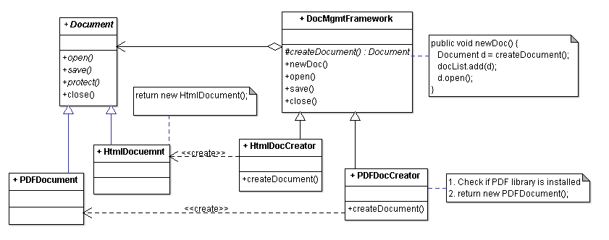
Factory Method Pattern
DocumentMgmtFramework
knows when to create a Document (when user selects the menu item
but DOES NOT anticipate what type of Document to create

Slide 22
Factory Method Pattern Example
Framework classes are all abstract and it does not change when new document types are added
DocumentMgmtFramework can also provide a default creation of a Document
Client provides new types of documents and document creation factory.
Later on you can add another type of document w/o changing DocumentMgmtFramework

Slide 23
Benefits
Introduces a separation between the application and a family of classes
Weak coupling instead of tight coupling hiding concrete classes from the application framework
Simple way of extending the family of products with minor changes in application code
It provides customization hooks

Slide 24
Abstract Factory Pattern
Context
Instead of one product, there could be multiple families of products which needs to be instantiated
System needs to be independent from the way the products it works with are created
Solution
Create a factory to instantiate objects specific to a particular family of products
One factory per product family

Slide 25
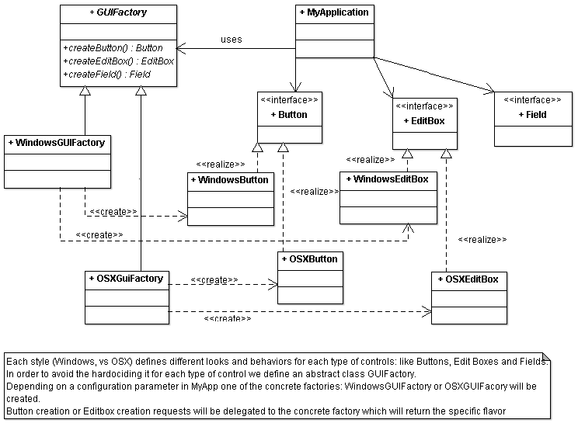
Abstract Factory Pattern

Slide 26
Singleton Pattern
Sometimes it's important to have only one instance for a class
For example, in a system there should be only one window manager (or only a file system or only a server object).
Usually singletons are used for centralized management of internal or external resources and
Provide a global point of access

Slide 27
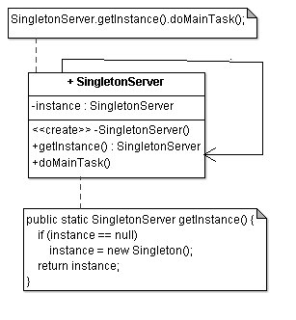
Singleton Example
A static member in the Singleton class
A private constructor
The constructor should not be accessible from the outside of the class to ensure the only way of instantiating the class would be only through getInstance()
A static public method that returns a reference to the static member
getInstance() method is used also to provide a global point of access to the object

Slide 28
Applicability Example
Logger Class
A logger is usualy implemented as a singletons, and provides a global logging access point in all the application components without being necessary to create an object each time a logging operations is performed.
Configuration Classes
Provides the configuration settings for an application
Not only a global access point, but one can keep the instance as a read-only cache object
Server object

